Slide 1

Application of fusion model based on multiple deep learning models in the detection and analysis of human skin piloerection
Slides from the dissertation for the degree of Master of Science in Data Science
Chunhui TU
Supervised by Dr. Richard Jiang
School of Computing and Communications
Lancaster University
September, 2023

Slide 2
Contents
Research Background
Research Methods
Results
Research Discussion
Conclusion

Slide 3
Research Background
PART 1

Slide 4
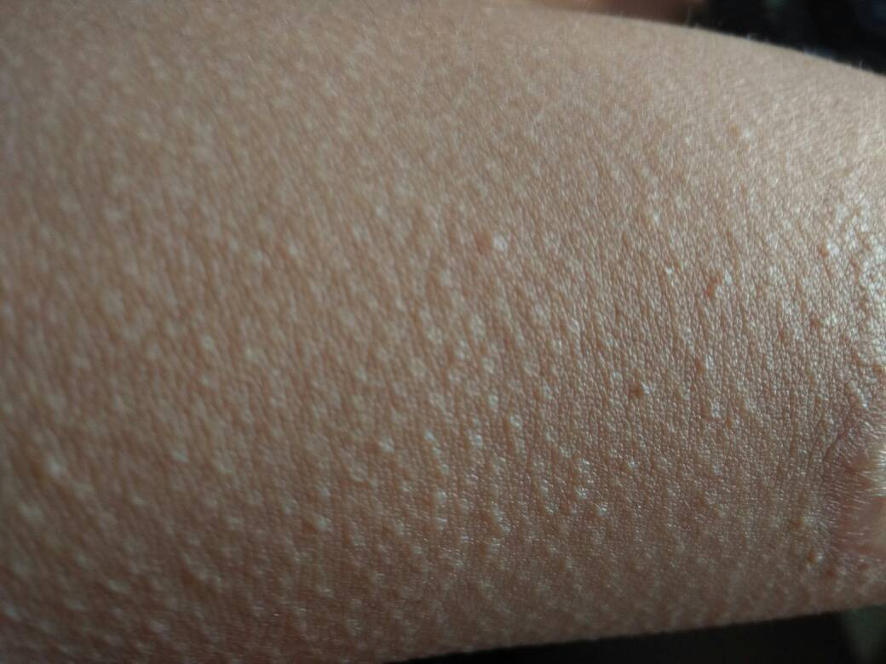

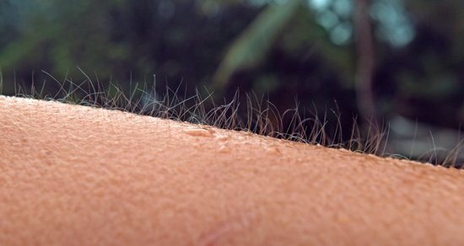
PART 1 Research Background
1.1 The correlation between piloerection and psychology
Empathy music
Shocking movie
frightened
excited
shocked
piloerection is the external reactions to people’s inner states
The Westsider, HAS YOUR PILOERECTION BEEN SHOWING? Available: https://thewestsider.com.au/has-your-piloerection-been-showing/
Baidu, Available: https://zhidao.baidu.com/question/1690655601055428468.html
Baobao, Available: https://baobao.baidu.com/question/3a61d4506a3f3c8d21b5db0f7c2af2e7.html

Slide 5
PART 1 Research Background
1.2 Application of deep learning in bioimaging
Image Recognition
Target Detection
Analysis & Decision
Output Results

Slide 6
Research Methods
PART 2

Slide 7
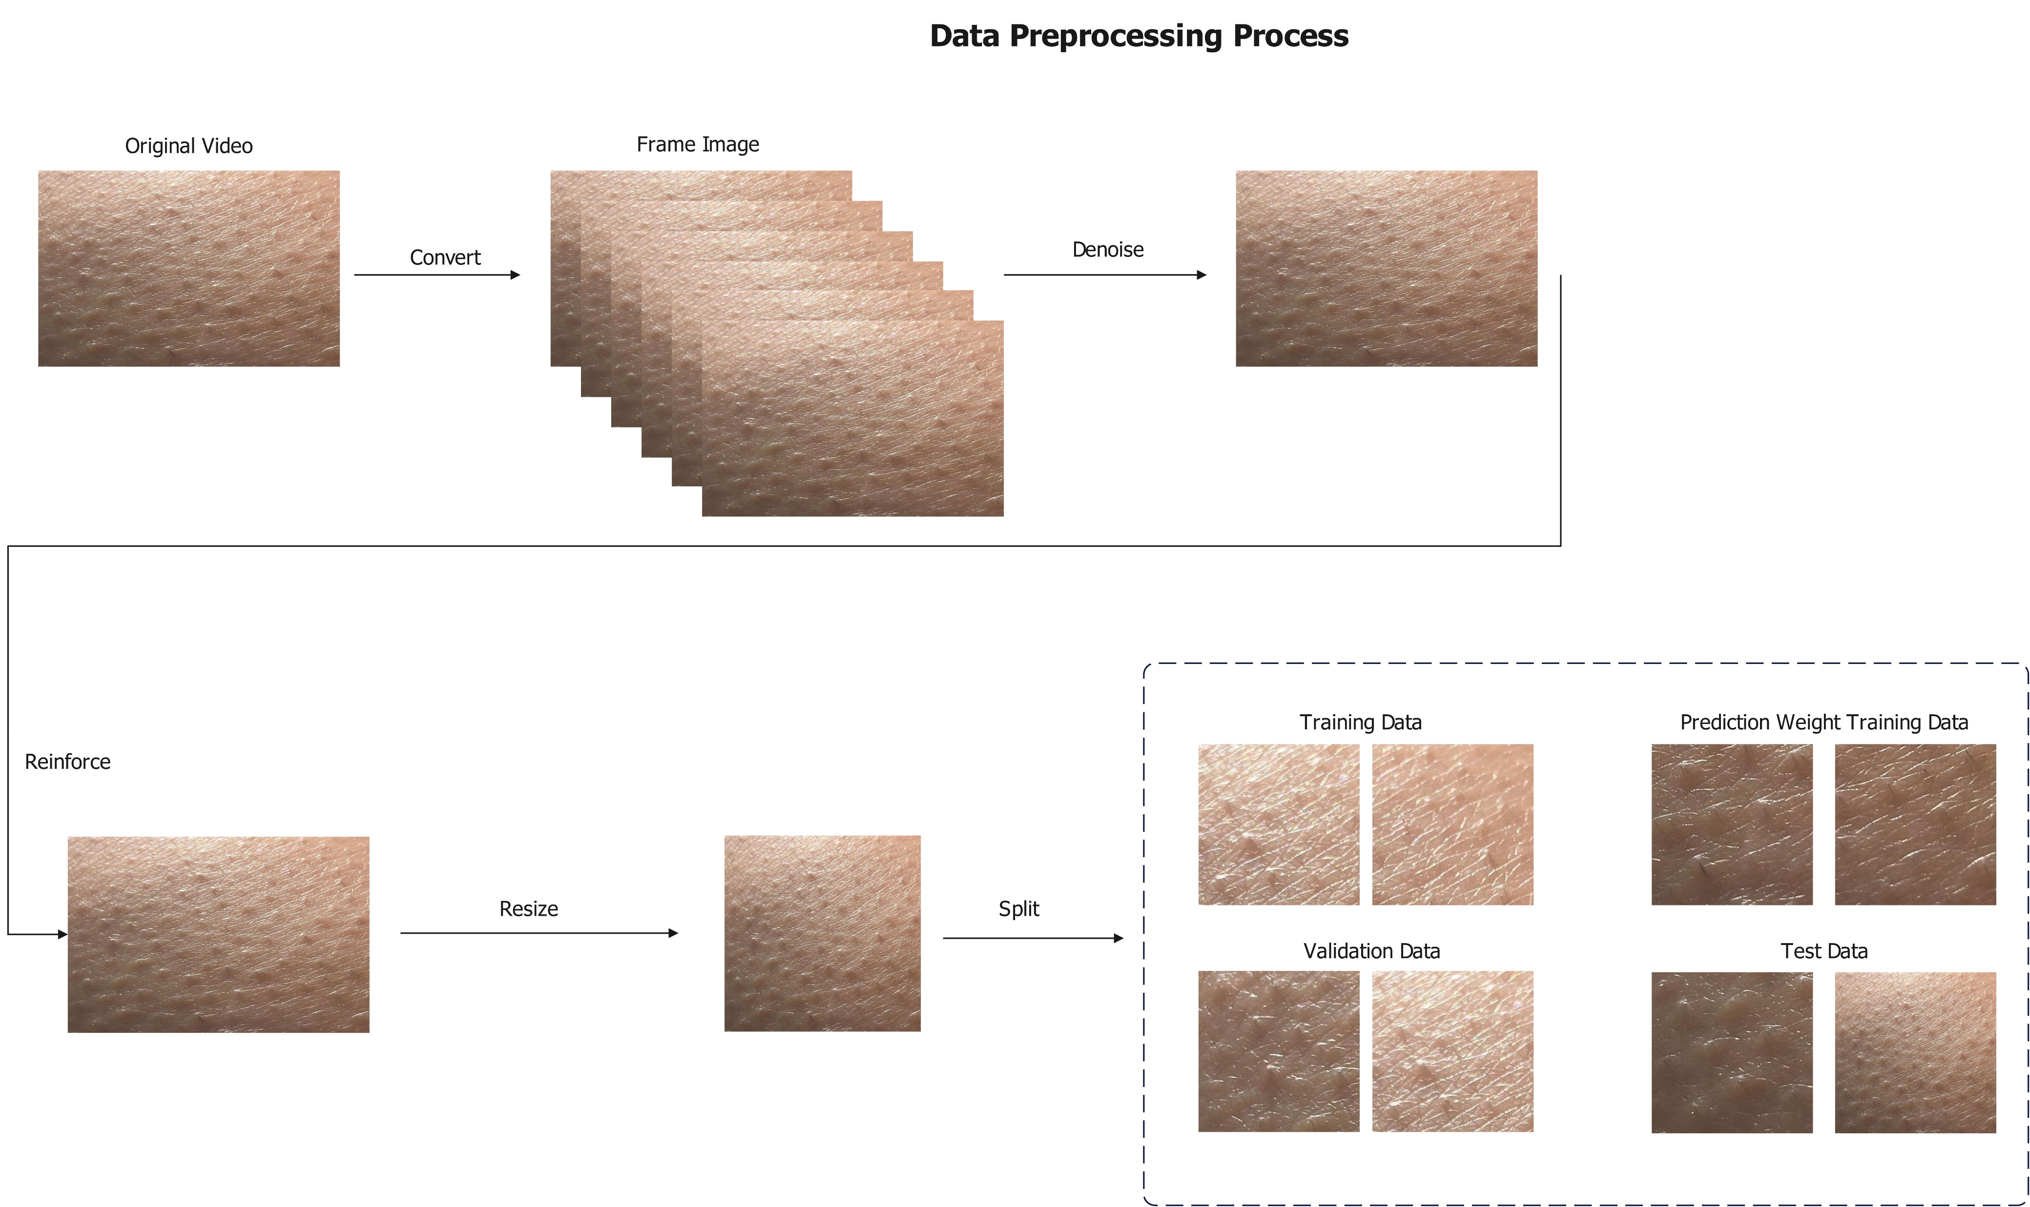
PART 2 Research Methods

Slide 8
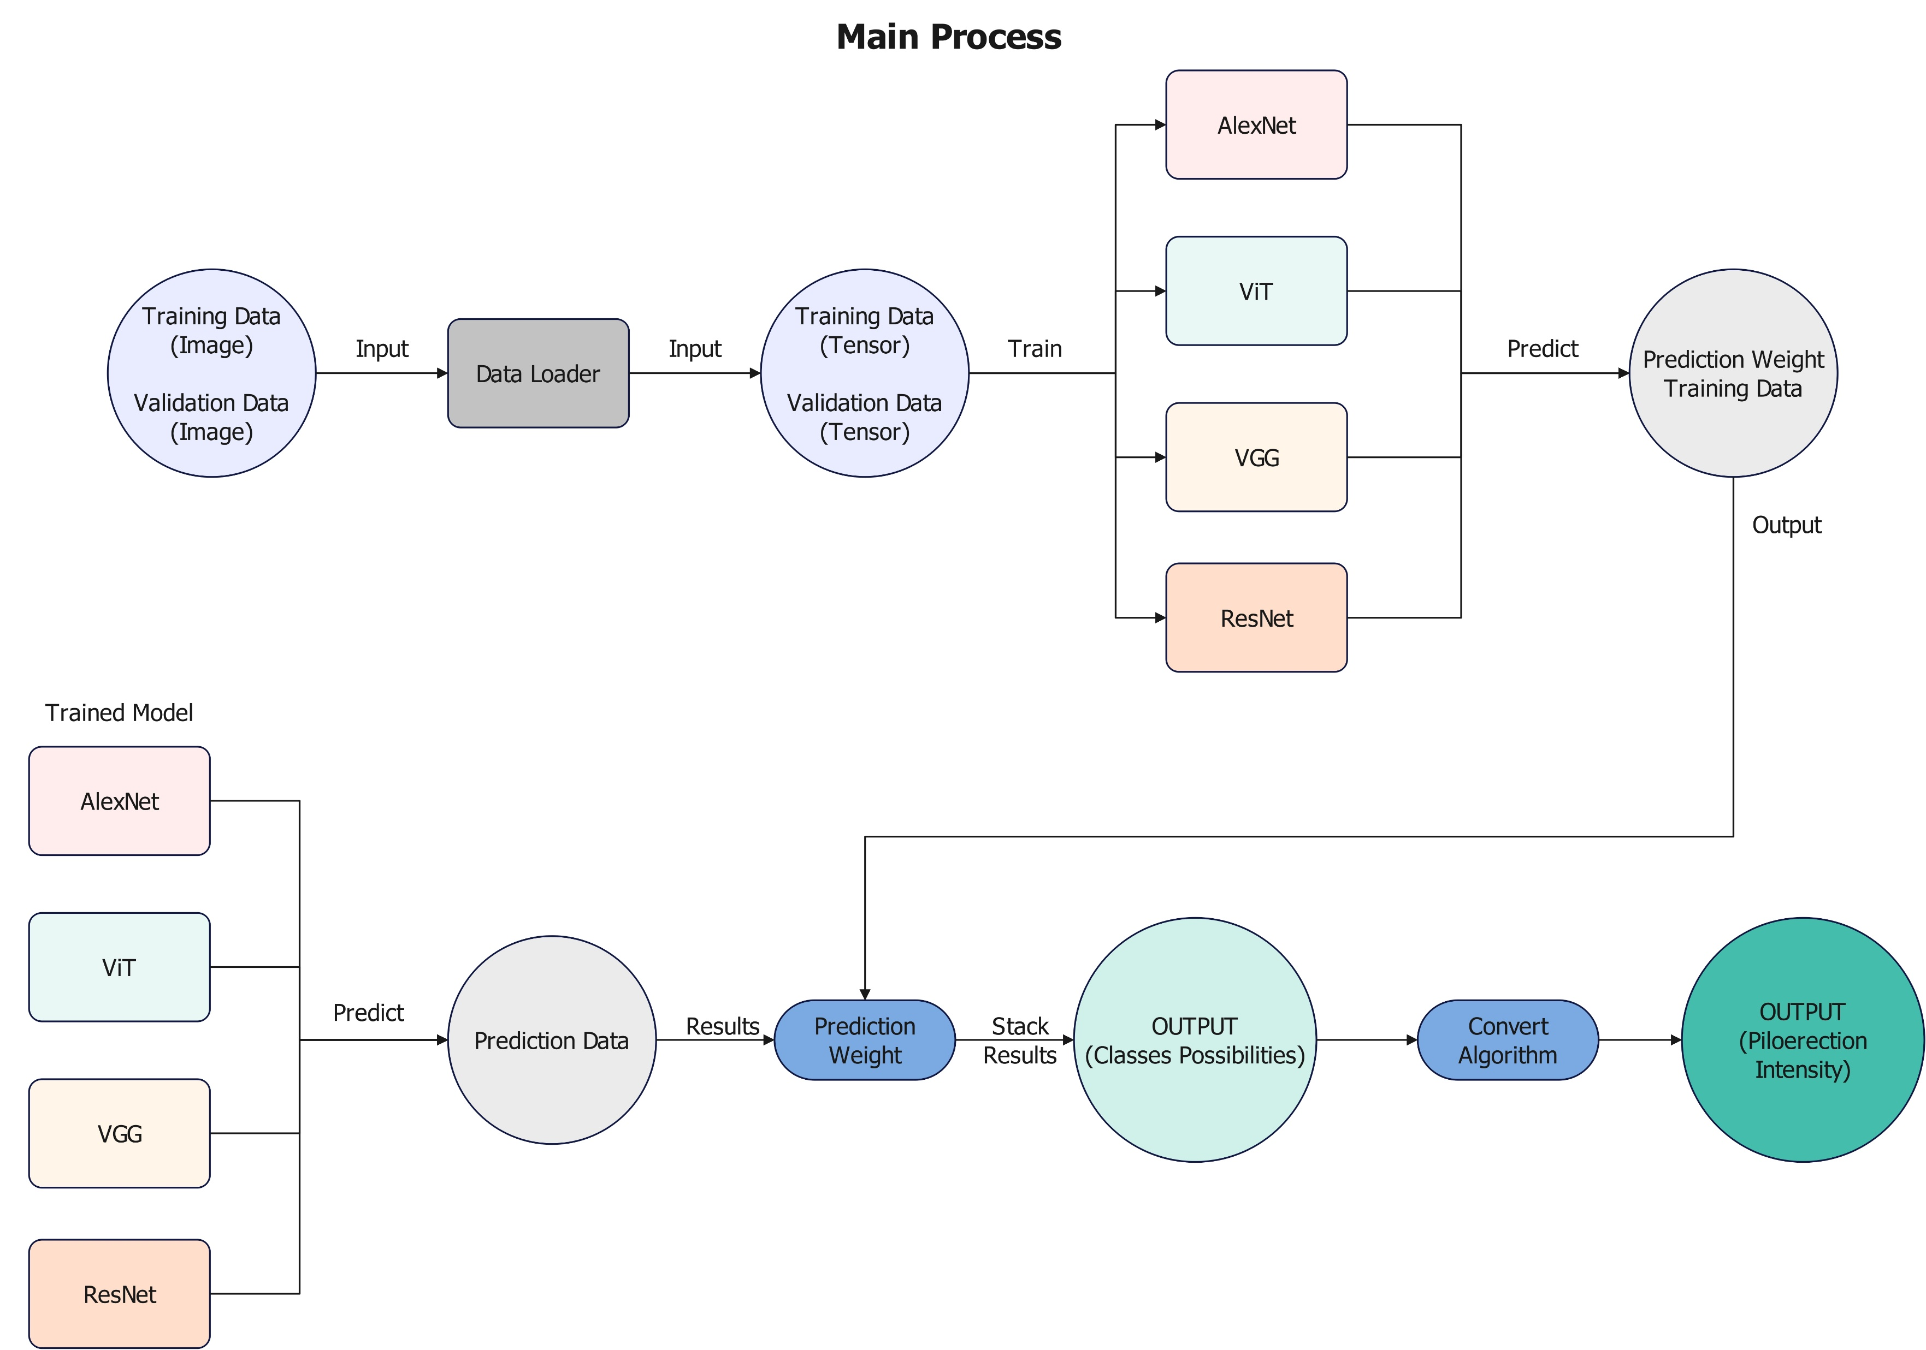
PART 2 Research Methods

Slide 9
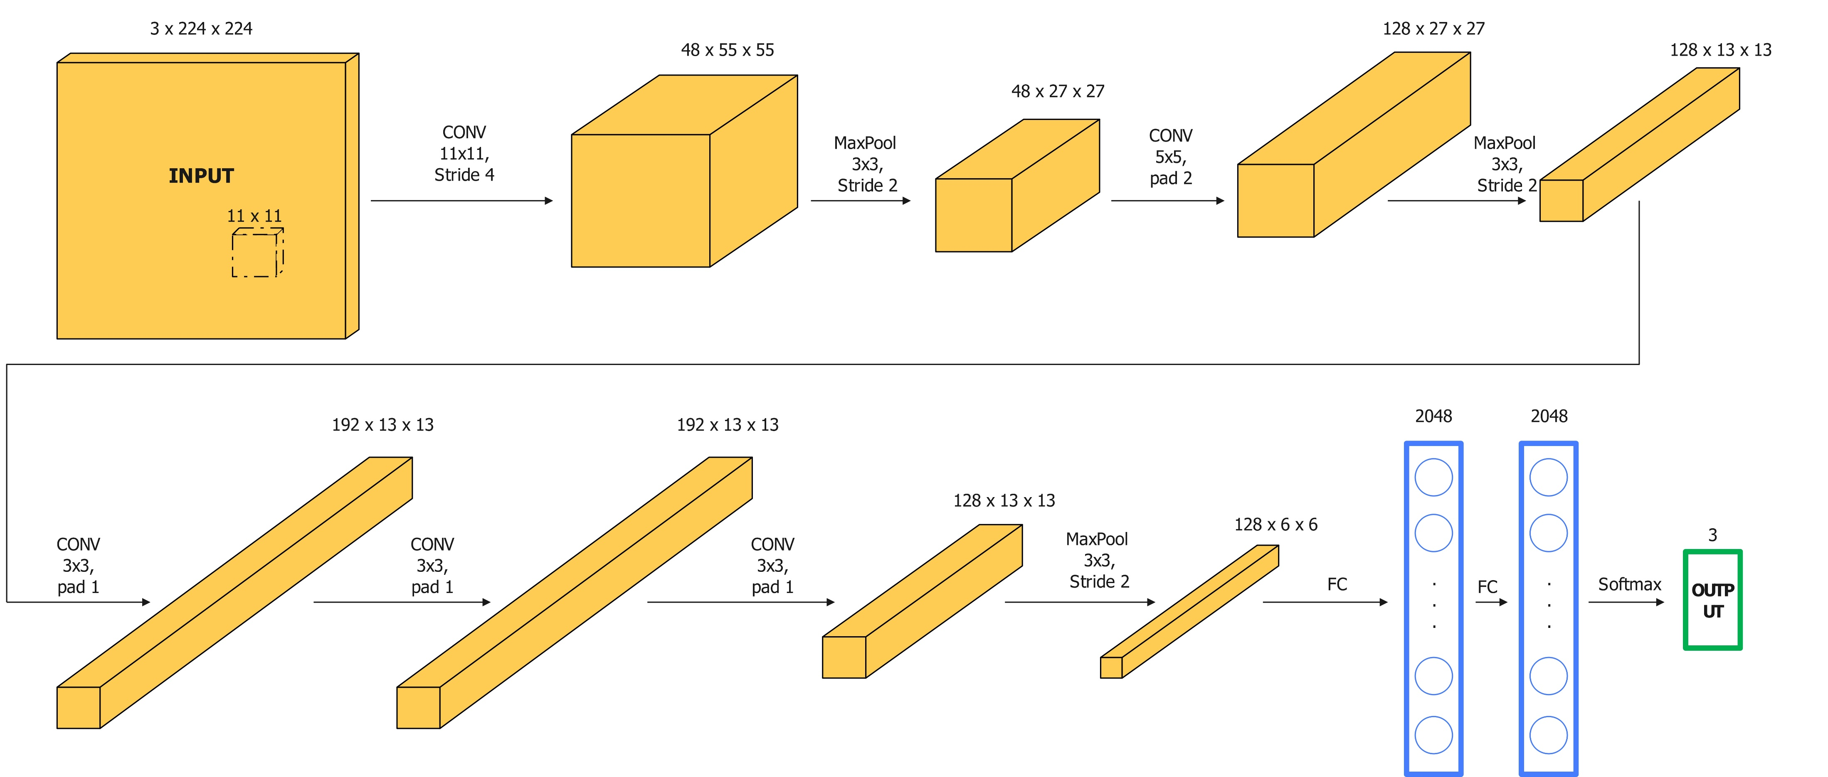
2.2 Applied model analysis
AlexNet
· ImageNet top-5 error rate of about 16%
· deep architecture
· Dropout prevents overfitting
· ReLu activation function avoids vanishing gradients

Slide 10
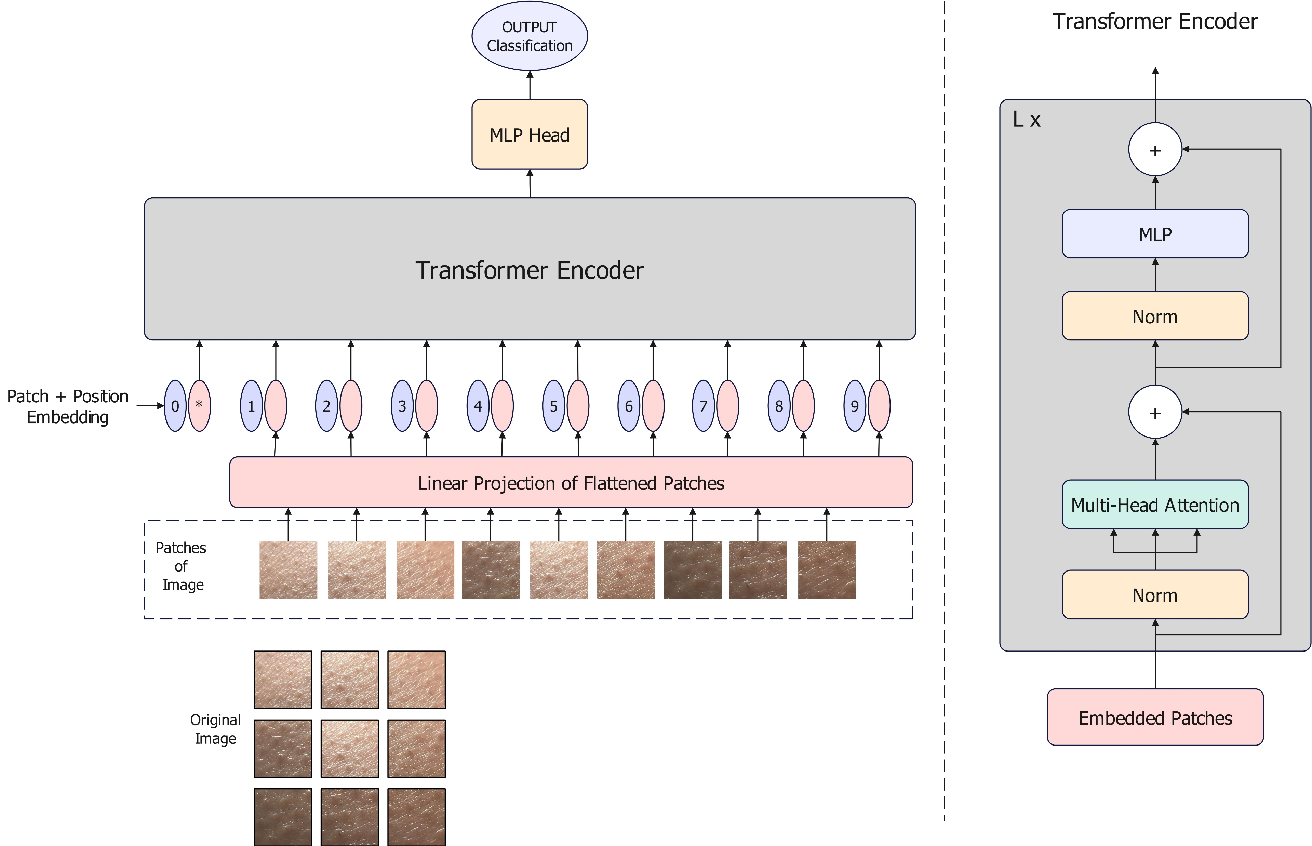
2.2 Applied model analysis
ViT(Vision Transformer)
global context awareness
-Better recognition of complex scenes
Few parameters
-The self-attention mechanism allows information to be shared at different spatial locations
Powerful generalization performance
-Less likely to overfit

Slide 11
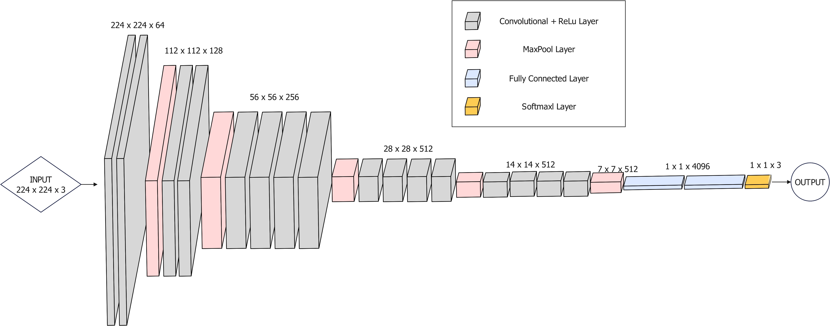
2.2 Applied model analysis
VGG(Visual Geometry Group)
Good generalization ability
Adaptable to a wide range of computer vision tasks
deep architecture

Slide 12
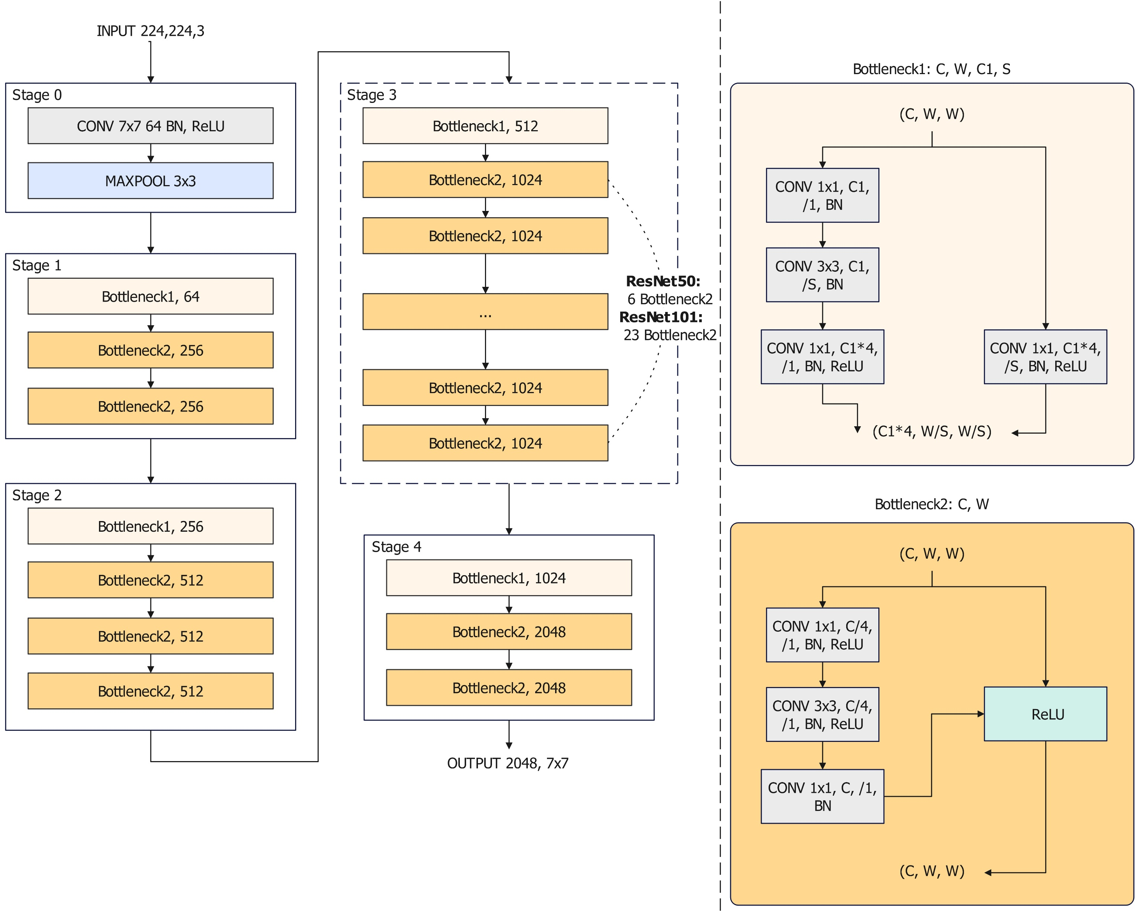
2.2 Applied model analysis
ResNet(Residual Network)
· Residual connections are better for training deep networks
· Better identify high-level features, retain low-level features, and improve generalization capabilities
· Efficiency (Residual connections)
· high performance

Slide 13
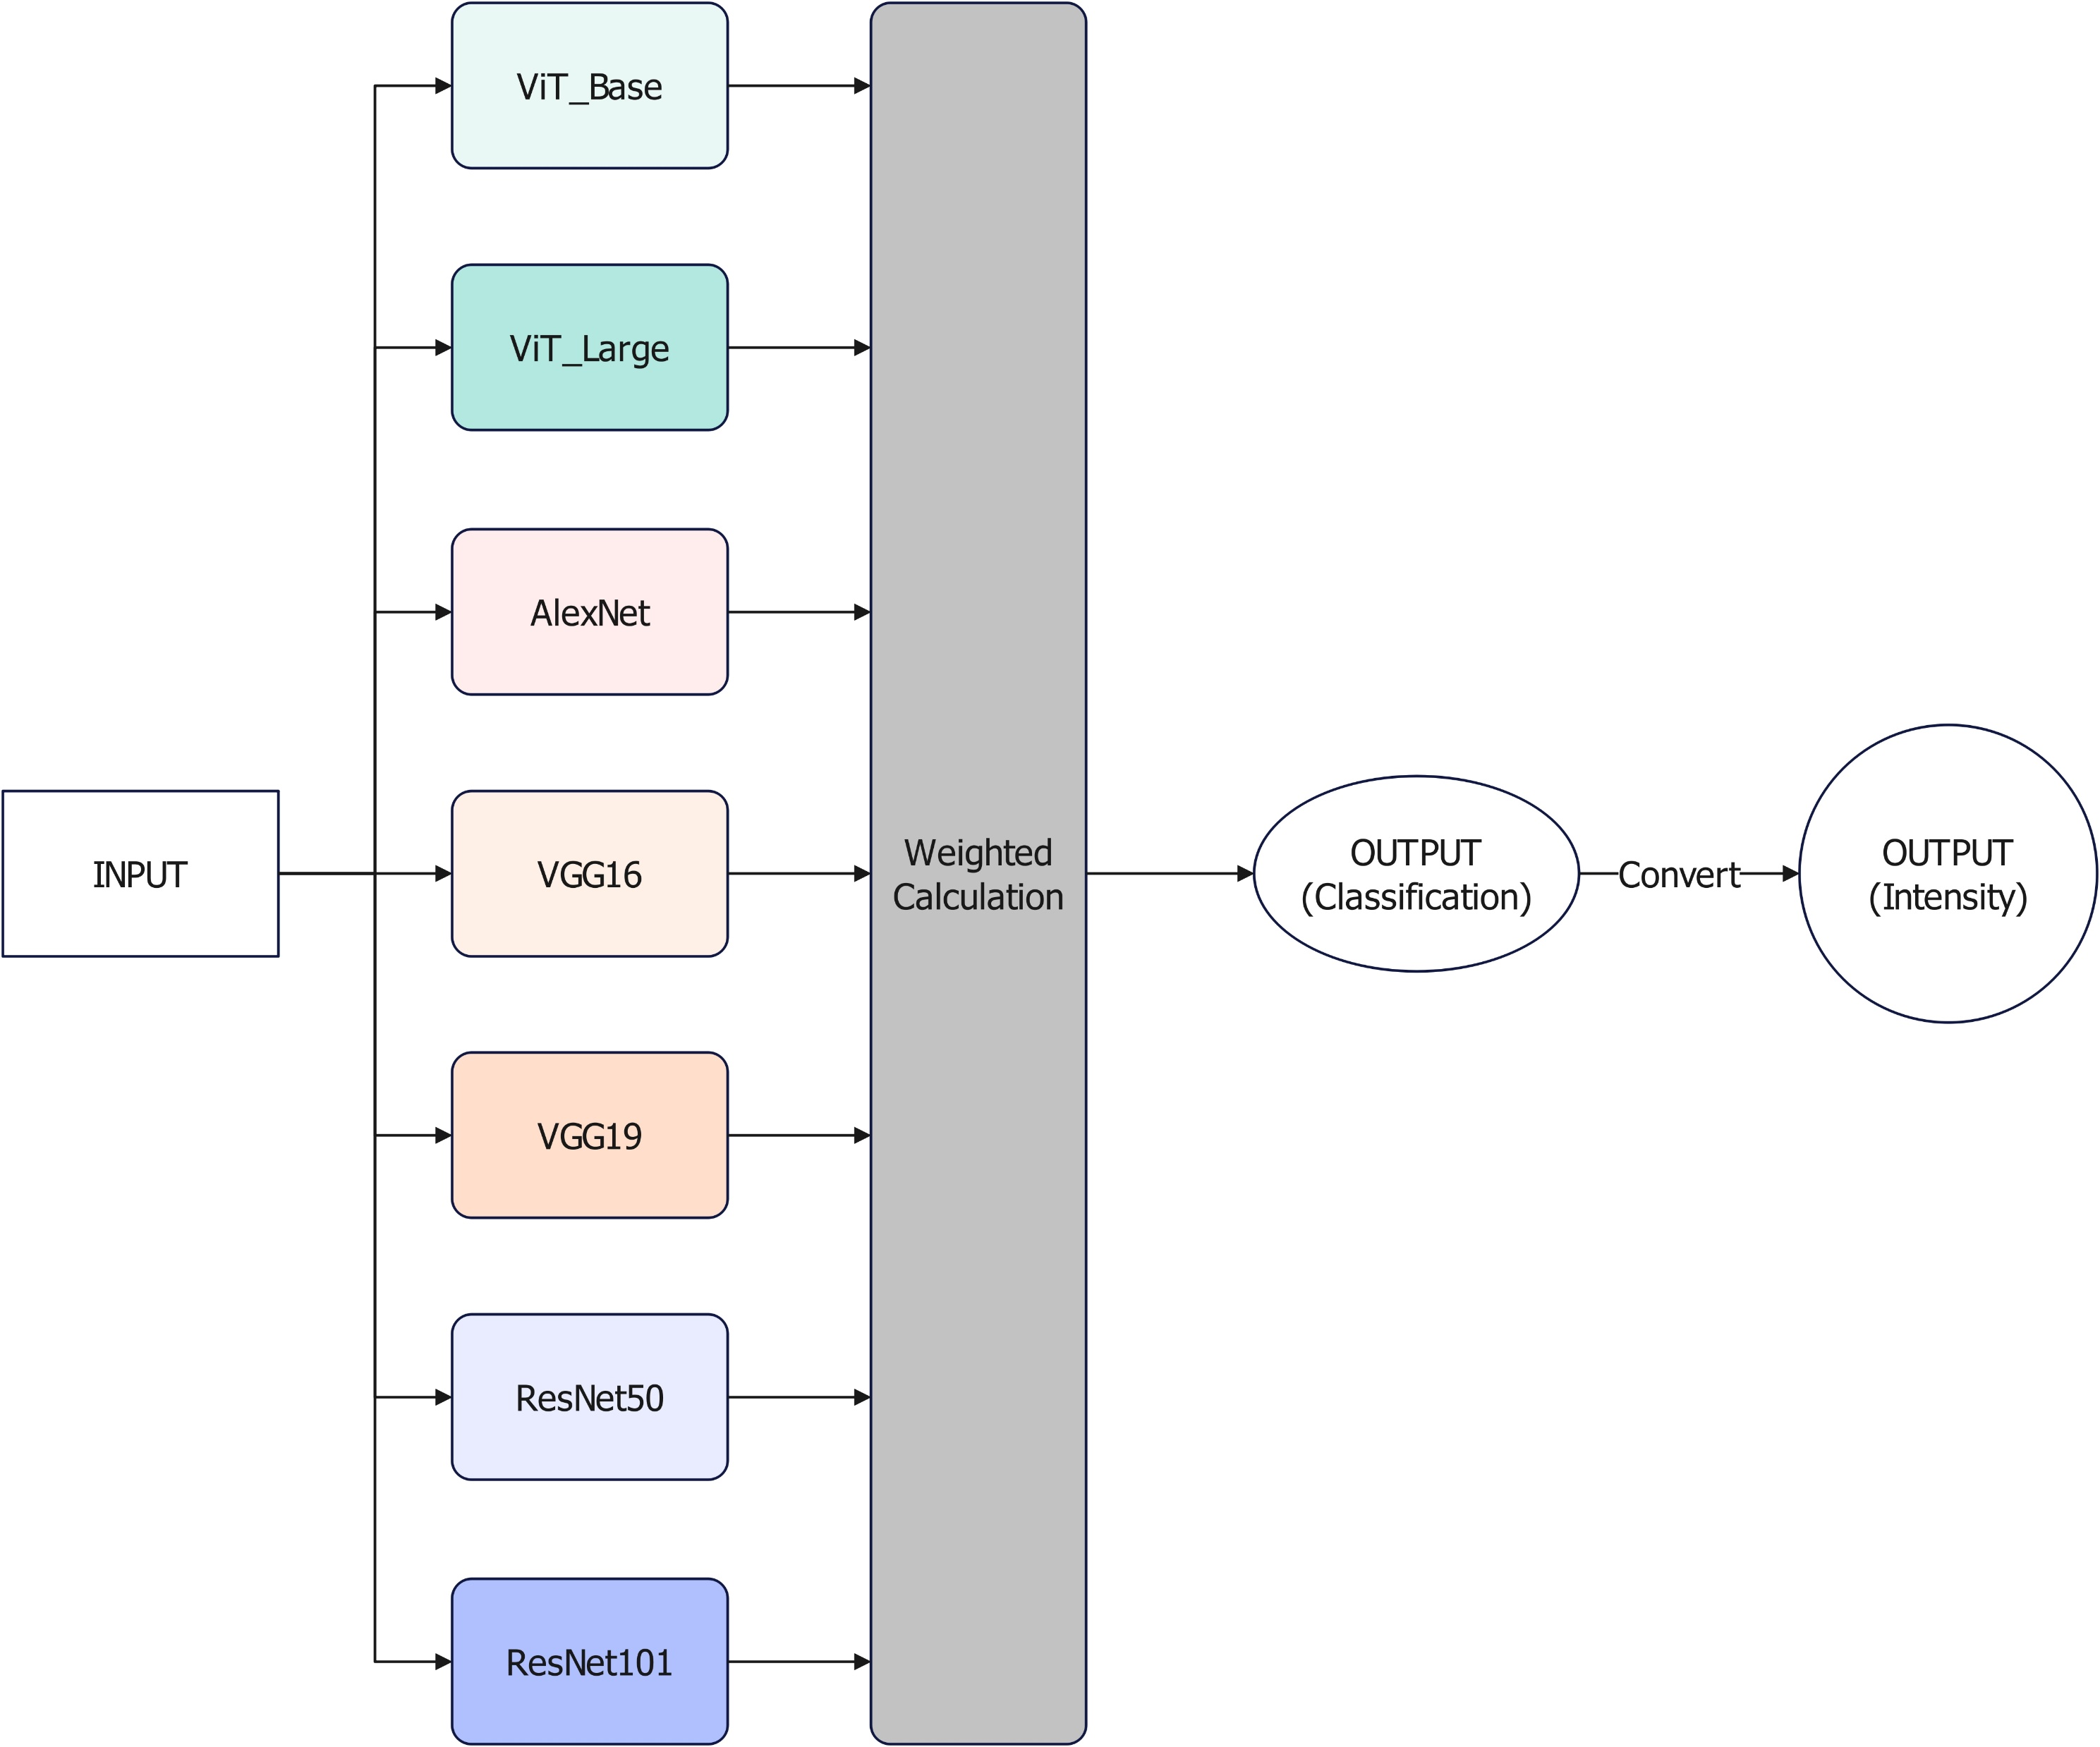
2.2 Applied model analysis
“The more the merrier”
Avoid single-model prediction errors
Improve overall forecast accuracy
Horizontally scalable
Computational overhead is controllable

Slide 14
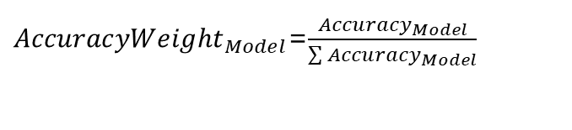
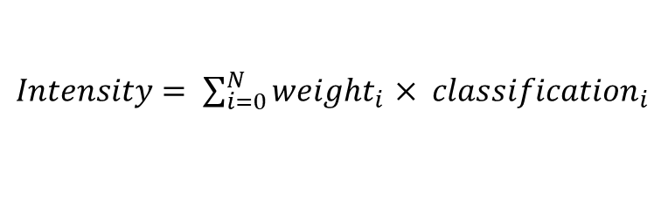
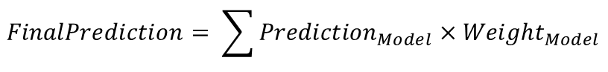
2.3 Key algorithm
Weighted Calculation
Intensity Conversion
$Intensity= \sum_{i=0}^{N}{{weight}_{i}}$ $× {classification}_{i}$
${AccuracyWeight}_{Model}$=$\frac{{Accuracy}_{Model}}{\sum{{Accuracy}_{Model}}}$
$$FinalPrediction= \sum{{Prediction}_{Model}×{Weight}_{Model}}$$

Slide 15
Results
PART 3

Slide 16
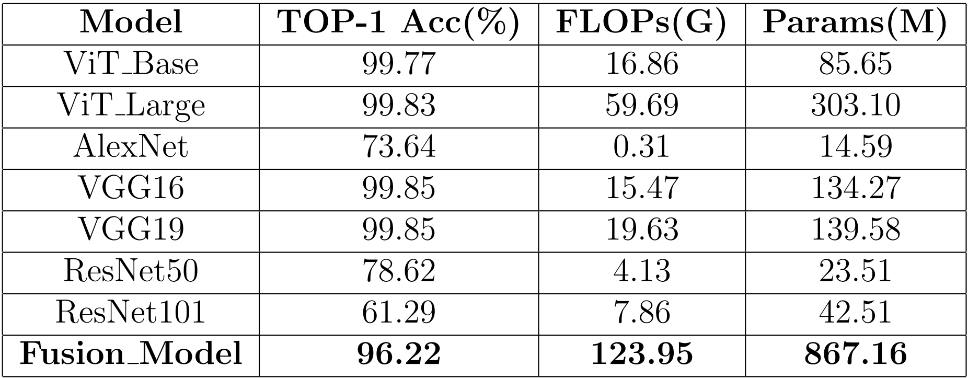








3.1 TOP-1 Accuracy and Resource Overhead of Different Models

Slide 17
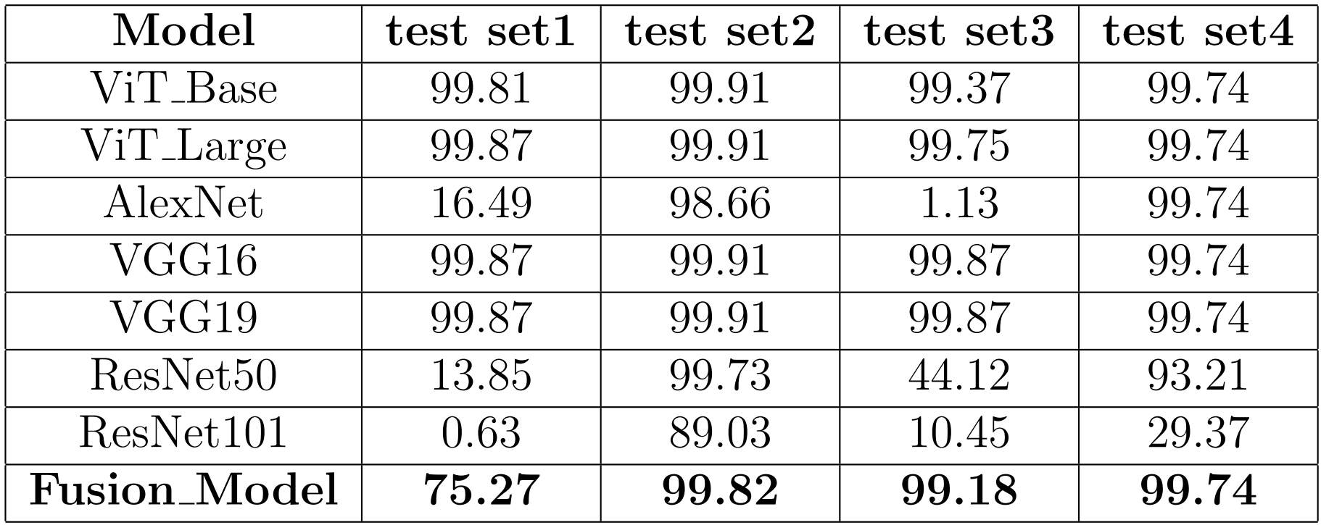











3.2 TOP-1 Accuracy of Different Models under Different Test Sets

Slide 18
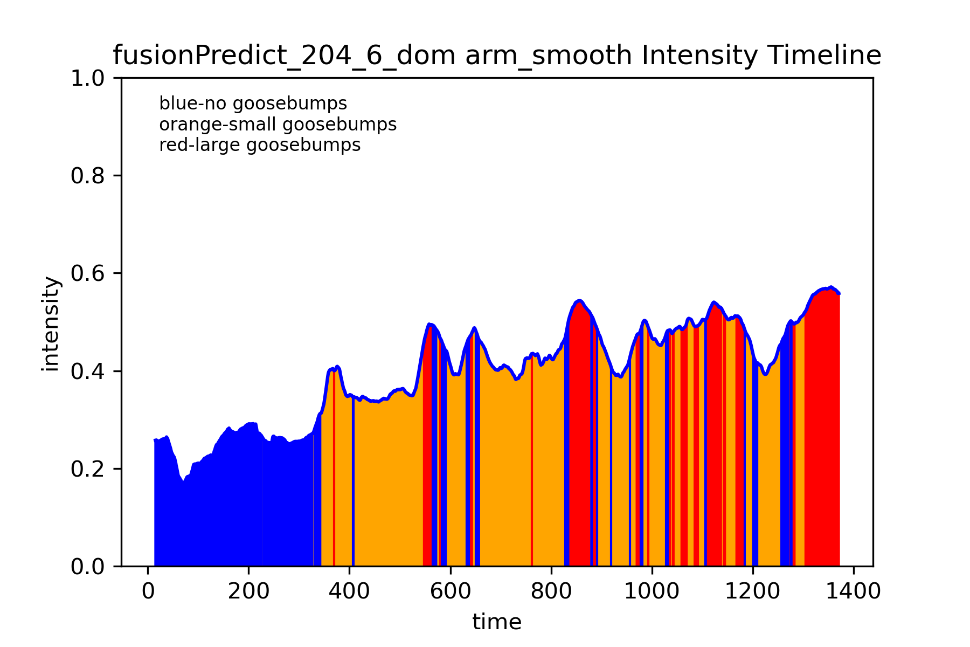
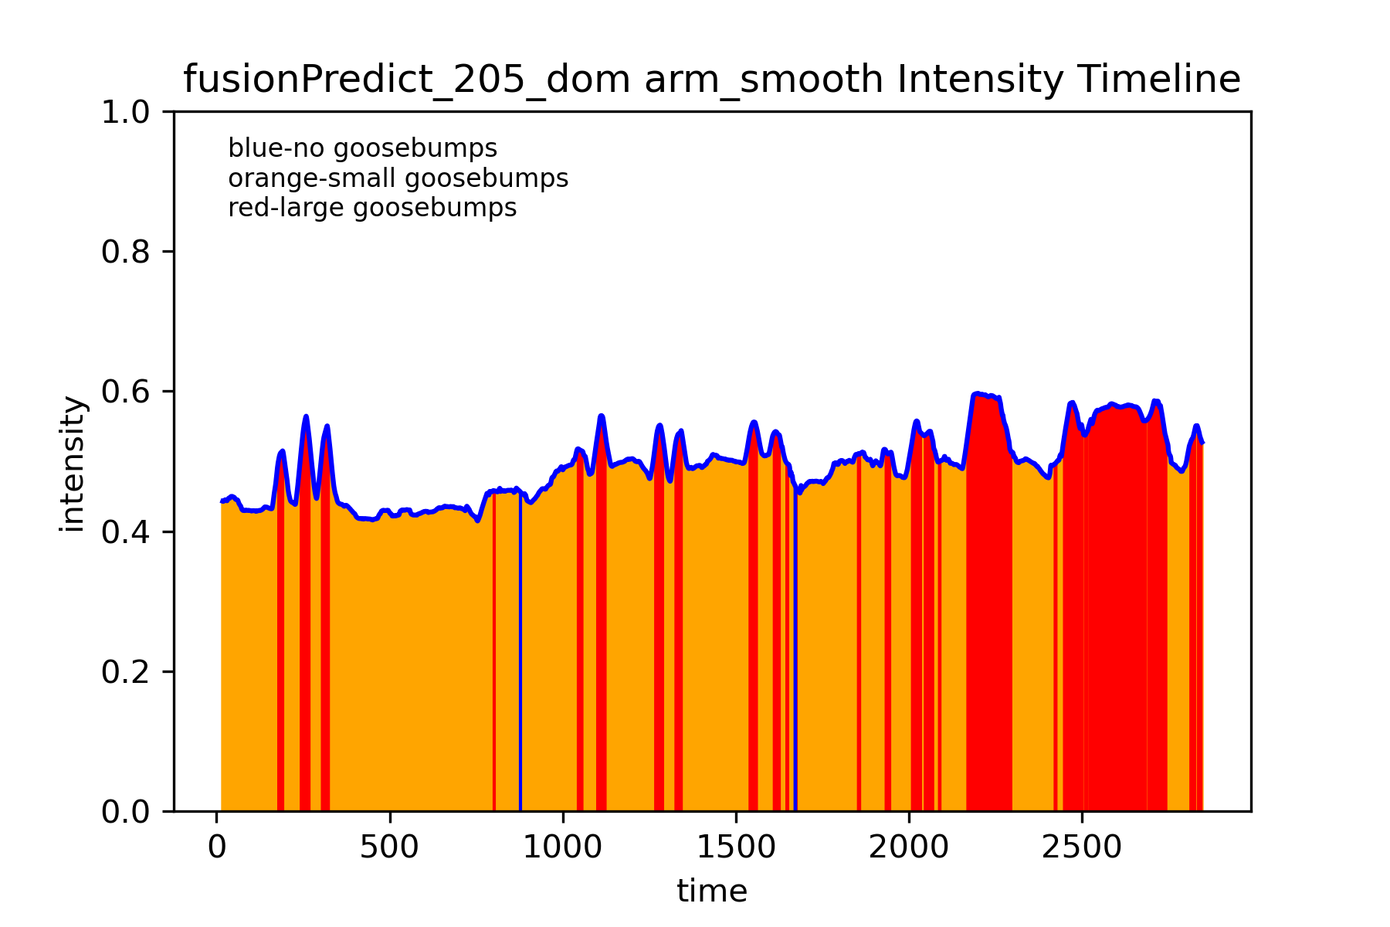
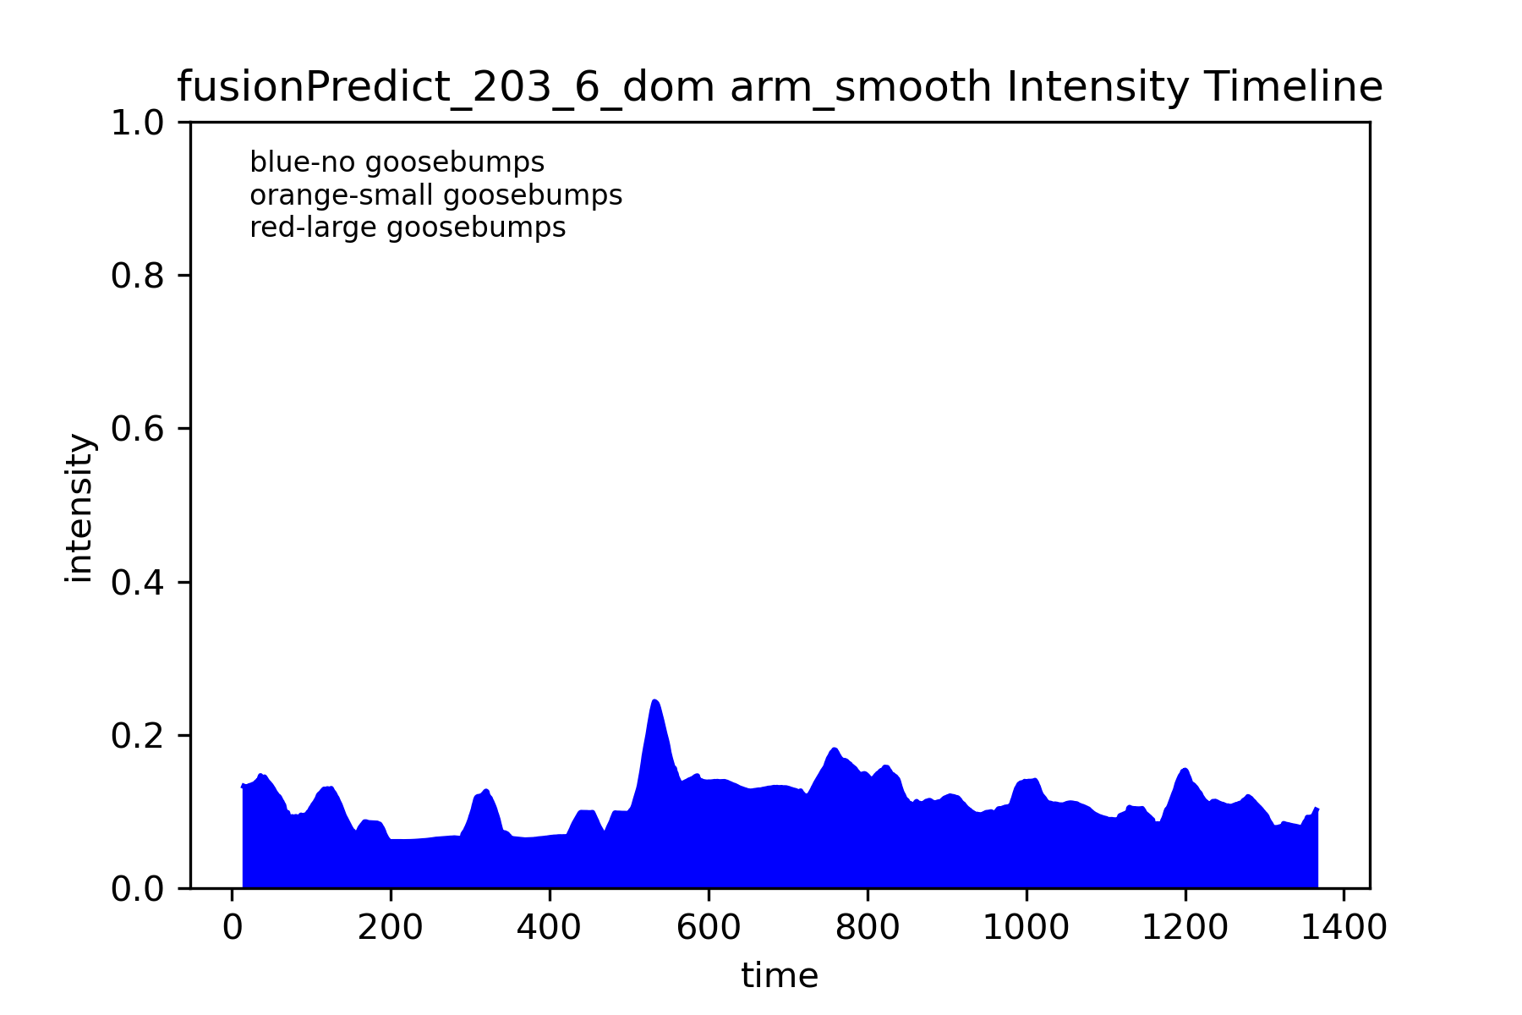
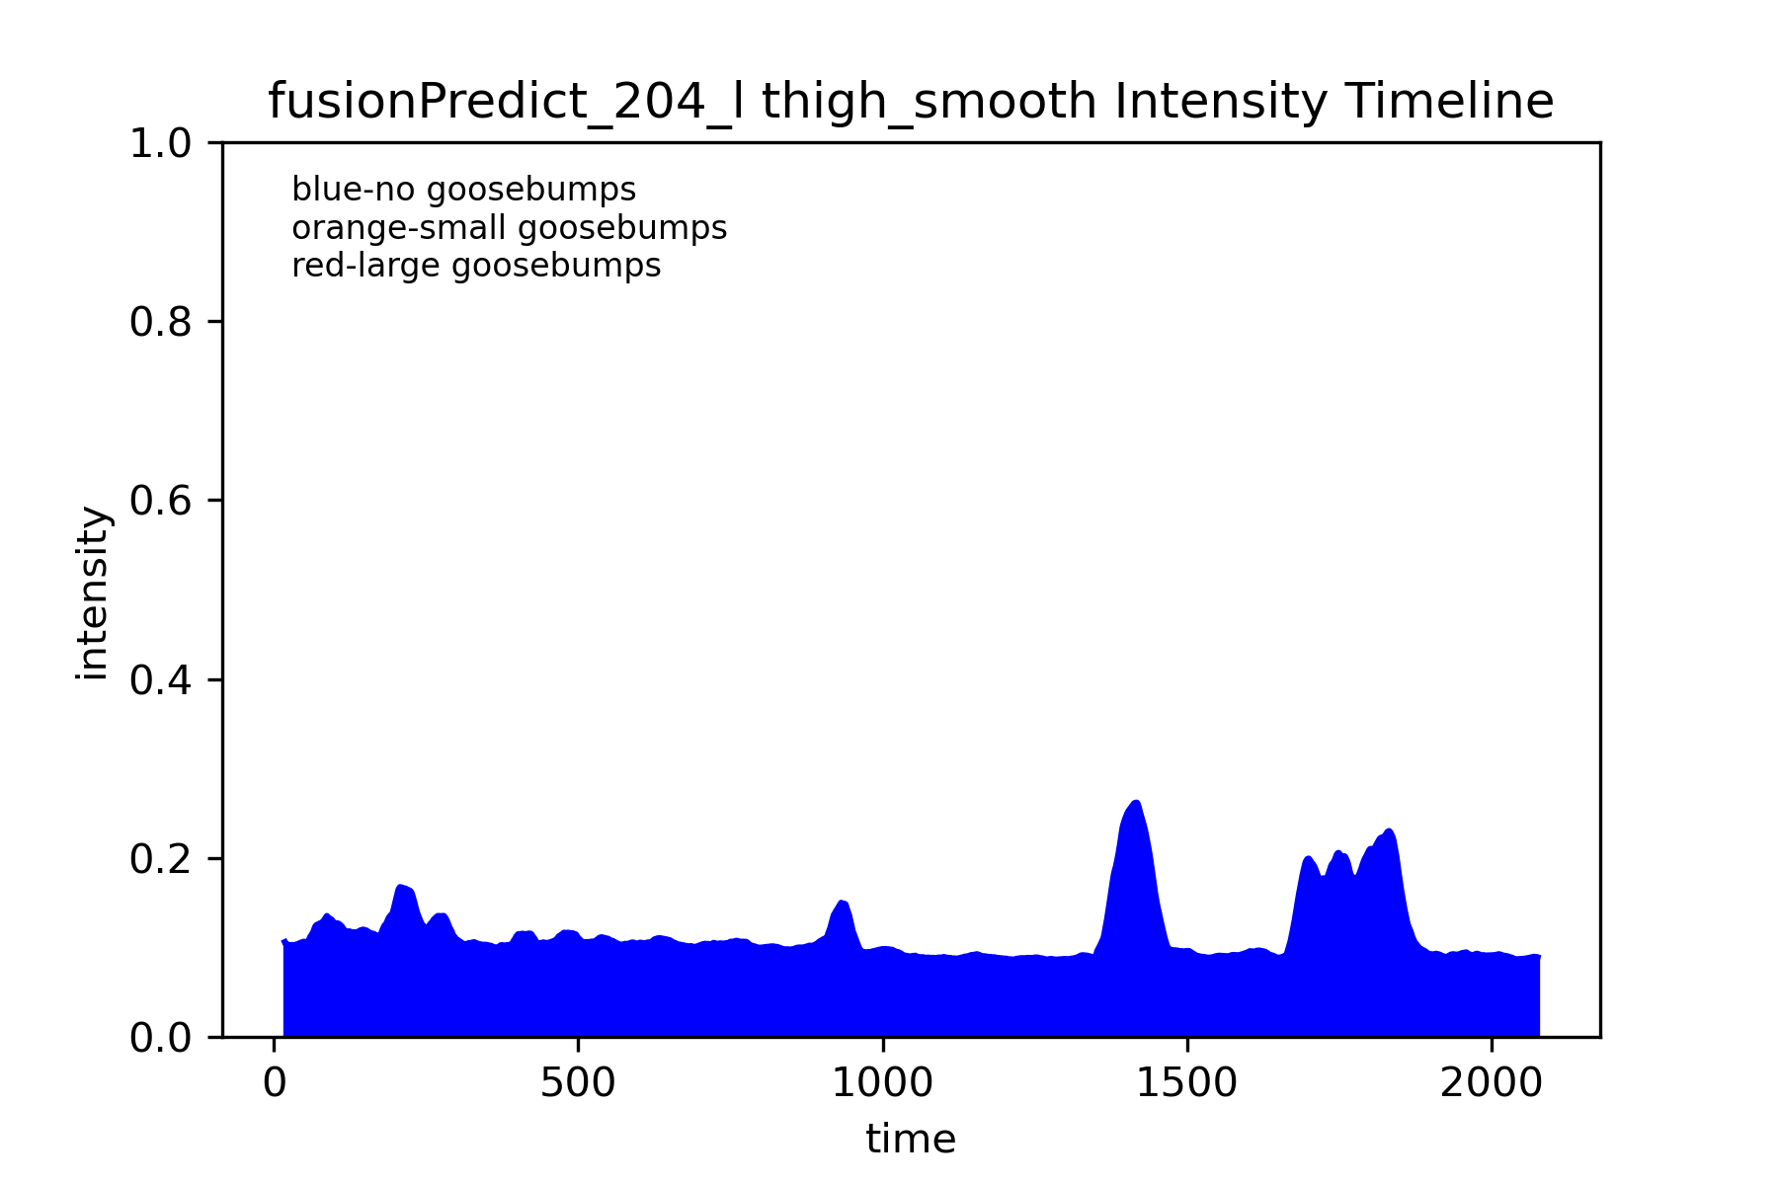
3.3 Piloerection Intensity

Slide 19
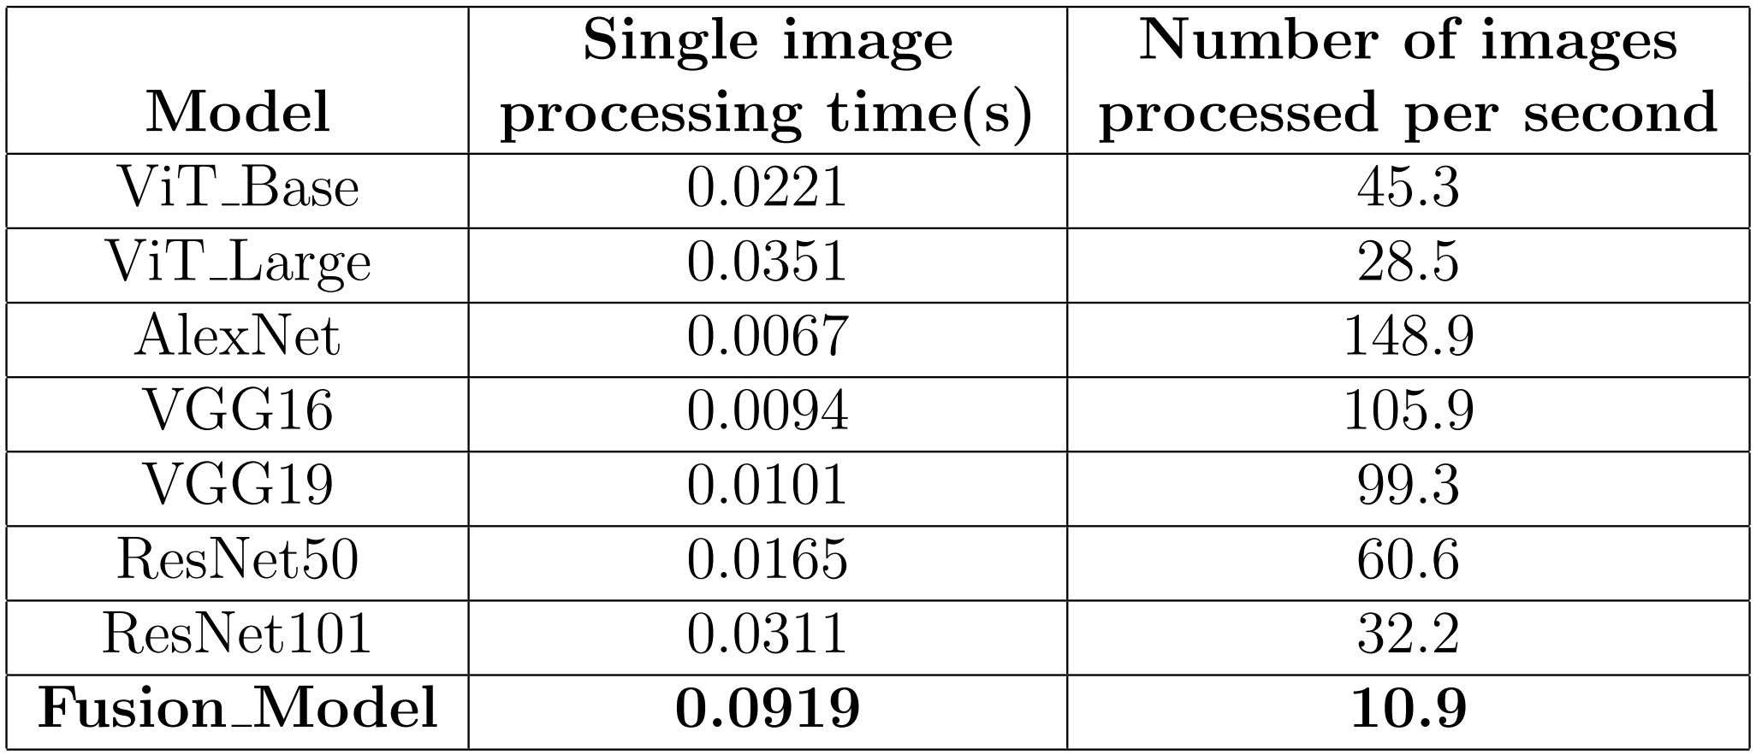
3.4 Prediction Processing Time of Different Models

Slide 20
Research Discussion
PART 4

Slide 21
4.1 Advantages
First applying deep learning models to the analysis of Piloerection
High prediction accuracy
Discrete categorical probabilities to continuous piloerection Intensity
Solve the problem of declining accuracy of a single model in certain data sets and improve the overall prediction accuracy
Controlled model resource overhead

Slide 22
4.2 Disadvantages
Limited Performance improvements when facing some skin problems, such as scars or acne
Accuracy reduction in Image blur, insufficient light, occlusion, viewing angle changes, and the influence of hair

Slide 23
4.3 Future Research Directions
Time series analysis: capture the possibility of correlation and dynamic changes between consecutive frame images.
Enhance model interpretability: better understand the model’s decision-making process
learn more in biology: Emotion, Gender, Race

Slide 24
Conclusion
PART 5

Slide 25



Fusion Deep Learning Model in Piloerection Analysis
96.22%
TOP-1 Acc.
Better
Overall
Acc.
Deep Learning in Piloerection
Acceptable Resource
Overhead
Slightly Limited
in
Complex Image
Time Series
Model Interpretability
More in biology

Slide 26
THANKS FOR WATCHING
Chunhui TU

